Slide 1
Knee cases
Notes:
PFPS (incorporate palpation of pes)
OA
Medial meniscus tear
MCL tear
ACL tear
ITB syndrome

Slide 2
Case #1: history
Chief complaint: 35 year-old with bilateral knee pain.
Onset: 2 years ago while in military service, hiking with heavy pack. No specific injury or event.
Location: Diffuse anterior knee pain, aching pain around patella .
Associated factors: No swelling. No locking, clicking. Sometimes feels knee "giving way" especially going downstairs*. No falls.
Exacerbating factors: Squatting, lunging, jumping, prolonged sitting, downhill/stairs worse than up. Unable to run now because of pain.
Notes:
• *Teaching point from history: Some patients may describe the affected knee as "giving way" or "buckling". In PFPS, this perceived instability may be due to pain inhibiting proper contraction of the quadriceps, but it must be distinguished from instability arising from a patellar dislocation or subluxation, or from ligamentous injury of the knee. Although some patients may describe a "catching" sensation under the patella, true locking of the knee or effusion are signs of intraarticular pathology NOT explained by the diagnosis of PFP.
PMHx: Non-contributory
PSHx: None
Meds: NSAID prn, minimal relief; NKDA
SocHx: No tobacco use, minimal ETOH. Going to college, no current employment.

Slide 3
Case #1: physical exam
Observation: No abnormality
ROM: Full extension, full flexion but pain anteriorly with deep knee flexion.
Palpation: Tender over the patellar facets, otherwise negative.
Stability Testing: No laxity on anterior/posterior drawer, Lachman’s, or varus/valgus stress testing.
Provocative Testing: Pain and guarding with patellar compression test. (-) McMurray’s Test.

Slide 4
Patellofemoral Pain Syndrome = Anterior Knee Pain = Runner’s Knee
Most common cause of knee pain seen by primary care, orthopedic surgeons, and sports medicine specialists
Definition
Diffuse, aching anterior knee pain that increases with activities
that place additional loads across the PF joint (run, squat, stairs)
Etiology
Multifactorial – overuse, overloading, malalignment
Degenerative changes = Patellofemoral OA not PFPS
Thomee R, et al. Patellofemoral pain syndrome: a review of current issues. Sports Med 1999; 28:245
Dixit S, et al. Management of patellofemoral pain syndrome. Am Fam Physician 2007; 75:194
Slide used with permission from Drs. Meg Pearson and Steve Bent
Notes:
Incr loads = running, climbing up/down stairs, kneeling, squatting
Obesity causes overloading
Malalignment can be involved but not required, may predispose to PF OA
Chondromalacia = pathologic changes to articular cartilage of patella

Slide 5
PFPS: Physical exam
KEY: Diagnosis is based primarily on history
Mechanism of injury: Rarely an acute injury, more often overuse
Pain: Under or around patella, aching to sharp
Mechanical symptoms: Popping sensation, “giving way”
Exam
Usually no effusion
Patellar signs (facet tenderness and + grind test)
Exacerbating factors – run, squat, stairs, sitting (theater sign).
Slide used with permission from Drs. Meg Pearson and Steve Bent
Notes:
running, jumping, squatting, lunges
Often presents bilaterally
Giving way – may have perceived instability due to pain inhibiting quad firing, look closely for patellar instability

Slide 6
PFPS: initial plan
Avoid exacerbating activities – squatting, lunging, running; find exercises that don’t exacerbate knee pain – often elliptical, cycling or swimming is tolerable
Continue or change NSAID, consider APAP
PT referral for LE conditioning, quadriceps and hip/core strengthening
Weight-loss if indicated (10x force factor through PF joint)
X-rays only indicated initially if hx trauma or surgery, presence of effusion. Consider in patients older than 50 to assess for PF OA/ chondromalacia patellae

Slide 7
PFPS: if does not improve
Xray if not improving with above treatment
May consider orthotics, taping and/or bracing
Referral to Orthopedics if failed all conservative management (limited surgical options)
If not improving and xray unrevealing, consider MRI to r/o structural etiology.
There is little evidence to support intraarticular CSI for PFPS

Slide 8
Case #2: history
Chief complaint: 60 year-old slightly obese female with complaint of deep aching pain and stiffness in both knees.
Onset: 3-year history of progressively worsening pain in both knees. Initially felt at work when lifting heavy materials, but more recently she has experienced pain in the absence of any physical activity or exertion.
Location: medial knee pain bilaterally
Associated factors: Intermittent swelling. Creaky, crackly sounds when knees move,not associated with increased pain. Occasionally feels as though one of her knees will give out. Denies knee catching or locking. Denies redness but sometimes experiences warmth or fullness in the knees.
Exacerbating factors: Damp weather, kneeling, squatting, and stairs all worsen her pain. Her knees are stiff for about 20 minutes upon awakening and for a few minutes once getting up from a chair after prolonged sitting. She has difficulty walking > 30 minutes so no longer walks her dog.

Slide 9
Case #2: physical exam
Observation: genu varum (bow-legged); mild antalgic gait; quadriceps atrophy. No skin changes.
ROM: Passive ROM of both knees demonstrates palpable, painless crepitus. She is unable to flex or extend her knees completely. Maximum flexion is to about 120 degrees with pain.
Palpation: Tenderness over medial joint lines and patellar facet bilaterally; right knee effusion
Stability Testing: No laxity on anterior/posterior drawer, Lachman’s, or varus/valgus stress testing.
Provocative Testing: (-)McMurray’s test (painful but no pop/click). (-) Noble test.

Slide 10
Knee osteoarthritis
Progressive, irreversible loss of cartilage
Knee has 3 compartments – OA can affect one, some or all compartments
Physical exam keys
Inspection: enlargement of bones, varus > valgus knees
Palpation: +/- effusion, lack of warmth, + crepitus, tender medial or lateral bony prominences (can also be tender at joint line)
ROM may be limited due to effusion or stiffness

Slide 11
Knee oa: initial plan
Avoid exacerbating activities – i.e. squatting, sitting for prolonged periods
Weight loss – losing even a small amount of weight can significantly decrease knee pain from osteoarthritis (1 lb. wt. loss = 3-5 lbs. of decreased knee pressure)
Exercise – strengthening the muscles around the knee makes the joint more stable and decreases pain. Stretching exercises help keep the knee joint mobile and flexible.
NSAIDs or Tylenol.
X-Ray – MUST be weight-bearing
MRI not indicated in setting of OA without catching or locking symptoms.
Consider intra-articular steroid injection
Consider therapies – i.e. topical creams with capsaicin, acupuncture
PT to strengthen muscles and increase flexibility
Discuss referral to surgery when above measures are insufficient to allow maintenance of function.

Slide 12
Case #2 further history
After you explain the diagnosis of knee OA, the patient tells you that last week she actually had an MRI of the knees on the outside showing a medial meniscus tear. She brings in a copy of the report which shows a right degenerative medial meniscal tear. Does this change your management?
Notes:
TREATMENT: same as outlined above.
KEY: Degenerative meniscus tears are a part of OA. Surgery is not effective and does not treat the OA which is the primary problem. So don’t get an MRI if the XRAY shows OA, unless you suspect malignancy).

Slide 13
Case #3: history
Chief complaint: 45 year-old with knee pain and swelling
Onset: 4 weeks ago, walking and stepped off curb wrong and twisted knee
Location: Medial joint line
Associated factors: Swelling noted that evening, not immediately following injury. Swelling worse after activity. Clicking sensation with twisting. Denies instability or locking.
Exacerbating factors: Squatting, twisting/pivoting on affected leg, walking long distances (swells).
Notes:
PMHx: Non-contributory
PSHx: None
Meds: NSAID prn, minimal relief; NKDA
SocHx: No tobacco use, minimal ETOH. Works as a car salesman.

Slide 14
Case #3: physical exam
Observation: Mild effusion of affected knee. No atrophy, skin changes, valgus/varus deformity.
ROM: Full extension, full flexion but pain over medial knee with deep knee flexion.
Palpation: Tender over the medial joint line, otherwise non-tender over patellar and quad tendons, lateral joint line, MCL/LCL, pes anserine bursa and patellar facets.
Stability Testing: No laxity on Lachman’s, varus/valgus stress testing or posterior drawer.
Provocative Testing: (+) McMurray’s Test with pain and a click medially. (+) Squat and Thessaly tests. (-) Noble.

Slide 15
Meniscus tear
Mechanism of injury
Acute – twisting or squatting injury
Chronic – degenerative with minimal or no trauma
Pain - joint line pain, sharp; may have popping, catching
Effusion
2-3 days after initial injury
Common after physical activity
Exacerbating factors
Twisting, squatting, deep knee flexion
Slide used with permission from Drs. Meg Pearson and Steve Bent
Notes:
Lock – concern for fragment trapped, limiting motion
VAGUE: Take into account the MOI, mechanical symptoms and PE findings to help diagnose.

Slide 16
Meniscus tear Physical Exam
Inspection: might notice effusion
Palpation: small – moderate effusion
ROM: effusion or bucket handle tear can limit ROM
Palpation: isolated joint line tenderness of affected side
Provocative Tests
Squat
McMurray
Thessaly
Notes:
Joint line tenderness reported to be sensitive (0.76) but not specific (0.29)¹
McMurray is specific (0.97) but not very sensitive (0.52) ¹
McMurray Test = painful click.
¹Evaluation of Acute Knee Pain in Primary Care. Ann Intern med. 2003; 139(7):575-588.

Slide 17
Meniscus tear: initial plan
Avoid exacerbating activities – squatting, twisting
Continue or change NSAID, consider APAP
May obtain imaging at first visit as patient has failed 4 weeks of home conservative care and continues to have mechanical clicking symptoms and pain/swelling
-X-ray – MUST be weight-bearing: Normal as above
-MRI – only AFTER x-ray is obtained to rule out any OA: meniscus tear as above
Referral to Orthopedics for consideration of knee arthroscopy with partial meniscectomy
PT for LE conditioning prior to surgery if pt. also has OA

Slide 18
Case #3b
WOULD YOU CHANGE YOUR MANAGEMENT IF THE X-RAY SHOWED:
Bilateral mild/moderate joint space narrowing, worse medially. Subchondral sclerosis, peaking of tibial spines, and several osteophytes.
WHAT WOULD YOU DO DIFFERENTLY?
Notes:
Consider intra-articular steroid injection
Achieve/maintain healthy weight (BMI<25)
Neither MRI nor arthroscopy are indicated in setting of OA without mechanical symptoms
Discuss referral to surgery when above measures insufficient to allow maintenance of function (for TKA)

Slide 19
Case #4: history
Chief complaint: 47 year-old with right knee pain
Onset: 2 weeks ago after a fall on a paddle board. His foot slipped out from under him and he felt a pop and acute pain at the medial knee when his knee fell into valgus
Location: medial joint line
Associated factors: no swelling, clicking or catching. Denies locking. Reports that his knee “feels loose,” particularly when changing direction or turning to his left.
Notes:
PMHx: no prior history of trauma or injury to the knee
PSHx: none
Meds: NSAIDS and acetaminophen, minimal relief
SocHx: no tobacco use, social EtOH. Is a software engineer, works at a start-up.

Slide 20
Case #4: physical exam
Observation: abnormal, antalgic gait, cautious. He prefers to sit with his hip in external rotation with weight on the lateral foot and a varus load on the knee
ROM: full ROM
Palpation: point tenderness at the MCL, both proximal and distal to the medial joint line. Not tender elsewhere on the joint lines or other parts of the knee
Stability Testing: (+) Laxity on valgus stress when the knee is flexed to 30 degress; No laxity with valgus stress with the knee in full extension. No laxity on Lachman’s, varus stress testing or posterior drawer.
Provocative Testing: (-) McMurray’s tests.

Slide 21
MCL tear
History
Force hits outside of the knee causing MCL to stretch and possibly tear (valgus stress to knee)
Pain medial knee
Knee feels stiff
Mild swelling
+/- instability

Slide 22
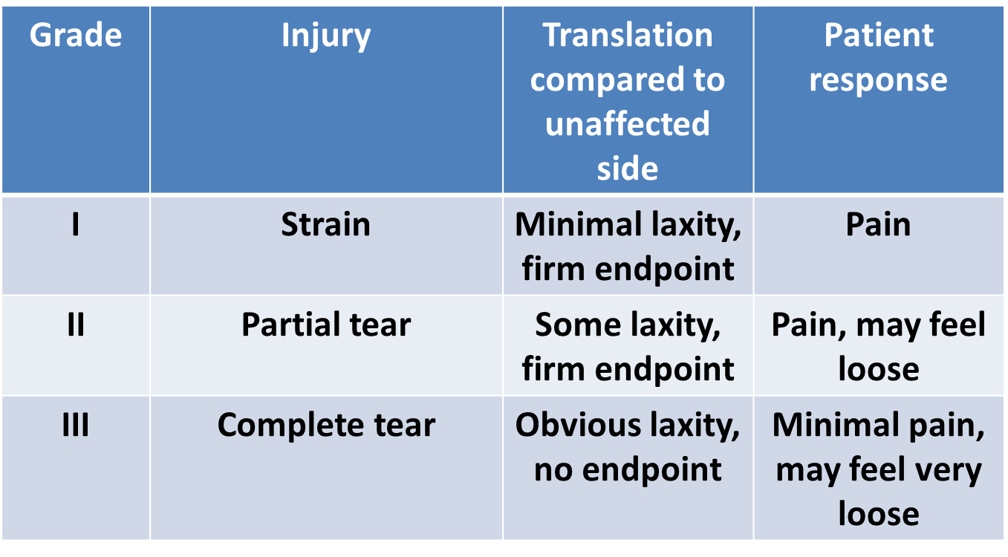
MCL tear: Severity graded by degree of laxity with valgus stress at 30 degrees
Notes:
This case = grade 2 MCL

Slide 23
Mcl sprain, grade 2: initial plan
Fit for double-hinged knee brace
PT referral
NSAIDs, ice – to control pain and decrease inflammation
Avoid exacerbating activities

Slide 24
Case #5: history
Chief complaint: 35 year-old woman with acute knee pain during trampoline half-pipe.
Onset: 3 days ago jumped down and felt a pop with immediate knee pain and swelling. Went to ER: placed in knee immobilizer and given NSAIDS.
Location: Posterior and lateral knee pain with terminal extension, tightness with bending.
Associated factors: Knee feels unstable if not in the brace, especially with cutting or pivoting.
Exacerbating factors: Instability with squatting, pivoting, walking down stairs, and stepping laterally (entire body weight on affected leg)
Notes:
PMHx: Non-contributory
PSHx: None
Meds: NSAIDS and Tylenol prn
SocHx: No tobacco use, minimal ETOH.

Slide 25
Case #5: physical exam
Observation: Using crutches, leg in immobilizer, large knee effusion. No skin changes, no valgus/varus deformity.
ROM: Lacks 5 degrees of extension, can only flex the knee to 100 degrees, limited due to pain (teaching point: determine if knee is locking--suggests concomitant meniscal tear- or if ROM is limited due to effusion)
Palpation: tender to palpation on the lateral femoral condyle and lateral tibial plateau
Stability Testing: (+) Lachman’s, +Anterior drawer.
Provocative Testing: (-) McMurrays. Deferred Thessaly and squat 2/2 instability

Slide 26
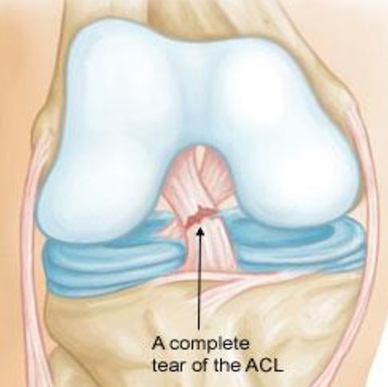
Anterior Cruciate Ligament (ACL) tear
Main stabilizing ligament of the knee
MOI
Twisting injury to knee (non-contact)
Rate is higher in women in certain sports
Orthoinfo.AAOS.org

Slide 27
ACL teaR
History
Often feel a pop
Swelling develops soon after the injury
May be unstable upon pivoting
PE
Effusion
Tenderness
+/- medial or lateral
+Lachman test
Very high sensitivity and specificity

Slide 28
Acl tear: initial plan
Rest, ice, compression, elevation
X-rays, MRI
Discontinue knee immobilizer but consider double-hinged knee brace
If knee is unstable, crutches to avoid weight-bearing if intolerant of double-hinged brace
OTC analgesics sufficient for most cases: Tylenol and NSAIDS
Consider aspiration +/- steroid injection to relieve effusion/hemarthrosis and help with pre-op goals of 1) walking without a limp, 2) return of full extension ROM, and 3) no effusion
Operative vs non-op management:
Most active, younger patients and high-level athletes opt for surgery.
For older patients and/or poor surgical candidates, trial non-op is reasonable
Ortho referral for most patients who are surgical candidates to discuss options.
Patients who decide not to pursue surgical management should be referred to PT or primary care sports medicine

Slide 29
Case #6: history
Chief complaint: 27 year-old presents with right knee pain
Onset: 2 weeks ago while training for his second triathalon
Location: just above the lateral joint line
Associated factors: no swelling, clicking or catching. Denies instability or locking.
Exacerbating factors: climbing stairs, running downhill or long distance. Cycling makes the pain worse. Pain resolves shortly after running and cycling.

Slide 30
Case #6: physical exam
Observation: abnormal gait (walking with the affected knee extended); varus knee alignment
ROM: full extension and flexion.
Palpation: point tenderness upon palpation of the lateral femoral condyle and at the lateral tubercle of the tibia (a.k.a Gerdy’s tubercle).
Stability Testing: No laxity on Lachman’s, varus/valgus stress or posterior drawer testing.
Provocative Testing: (+)Noble test. (-) McMurray’s, squat and Thessaly tests.

Slide 31
IT Band Friction Syndrome
History
Pain at lateral femoral condyle or inferior to it
Due to repetitive motion of knee (i.e running)
As ITB becomes increasingly irritated, symptoms typically begin earlier in an exercise session
PE
TTP of lateral knee approx. 2 cm above joint line
TTP worse when patient is standing and knee is flexed to 30 degrees
Positive Noble

Slide 32
ITB syndrome: initial plan
Avoid exacerbating activities – i.e. running on pavement, cycling. Consider swimming (using only arms) to maintain cardiovascular fitness until inflammation reduced.
PT referral for hip and core strengthening
NSAIDs, ice – for pain and decrease inflammation
Obtain new running shoes if there is uneven or excessive wear
Identify anatomic factors that may contribute to ITBS:
Leg-length discrepancy: consider a prescription heel-lift
Foot pronation or supination: consider orthotics

Slide 33
ITB syndrome: follow-up plan
After acute inflammation has resolved, start hip/core strengthening and a stretching program, which should include active stretching of the hamstrings, gluteal musculature, and hip adductors to improve the flexibility of the ITB.
Avoid running on banked surfaces and/or hills or running in the same direction on a track.
Cyclists
Modify their cleats to ensure they are adjusted to reflect the cyclist’s anatomic alignment, or the cleats can be externally rotated to reduce stretch on the ITB. If the cyclist is riding with fixed, clipless pedals, a switch to floating pedals is often beneficial.
Saddle or seat position should be adjusted so that 30-35 degrees of flexion is present at the bottom of the pedaling stroke. Consider reducing stress on the ITB by widening the cyclist’ bike stance and by improving both hip and foot alignment. This can be corrected by placing spacers between the pedal and the crank arm.

Slide 34
Itb syndrome: failure to improve
Surgical intervention is not indicated for ITBS except in rare cases in which prolonged conservative treatment has failed to alleviate the patient’s symptoms.
Sports medicine specialist consultation can be helpful
Local corticosteroid injection can help manage inflammation for those who do not respond to analgesia and rest

